Slide 1
Bloom CALM Programming the Cloud
Joe Hellerstein
Peter Alvaro

Slide 2
Agenda
Brief research background from the BOOM project
http://boom.cs.berkeley.edu
A taste of CS194-17, “Programming the Cloud” and the bloom language
Some related work

Slide 3
BOOM
In an era of cheap compute and ubiquitous data…
… Productivity is a key grand challenge in computing.
Berkeley Orders Of Magnitude project OOM bigger systems, OOM less code.
Significantly improve productivity for developers of distributed systems.

Slide 4
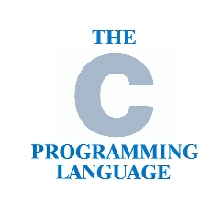
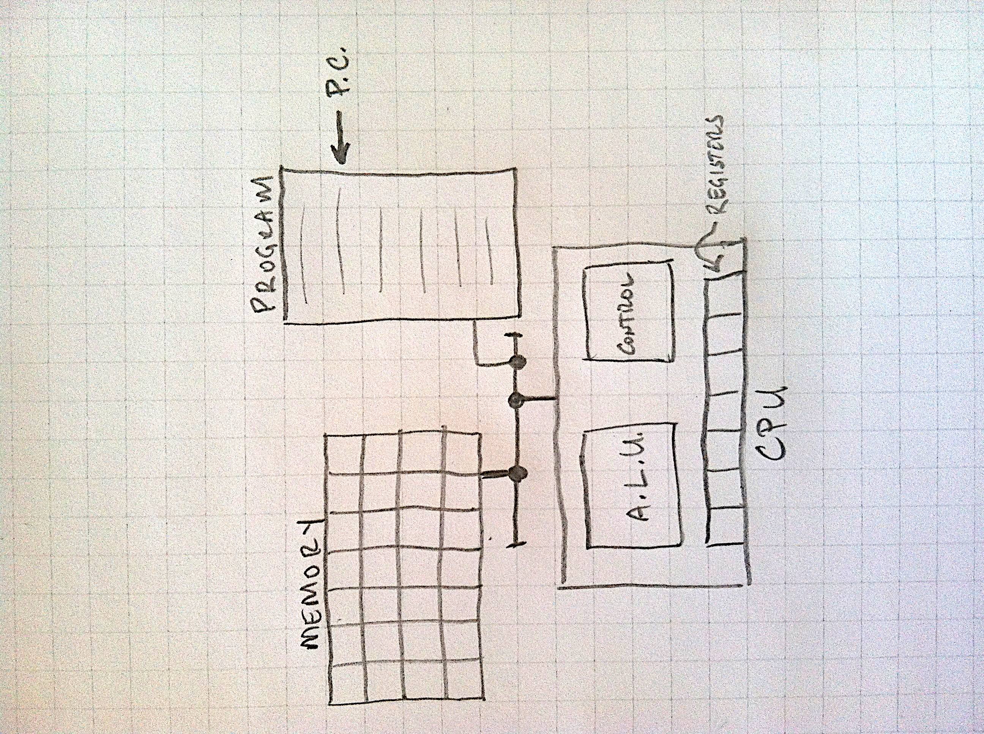





THE
von NEUMANN
MACHINE
ORDER
LIST of Instructions
ARRAY of Memory
THE STATE
Mutation in time

Slide 5
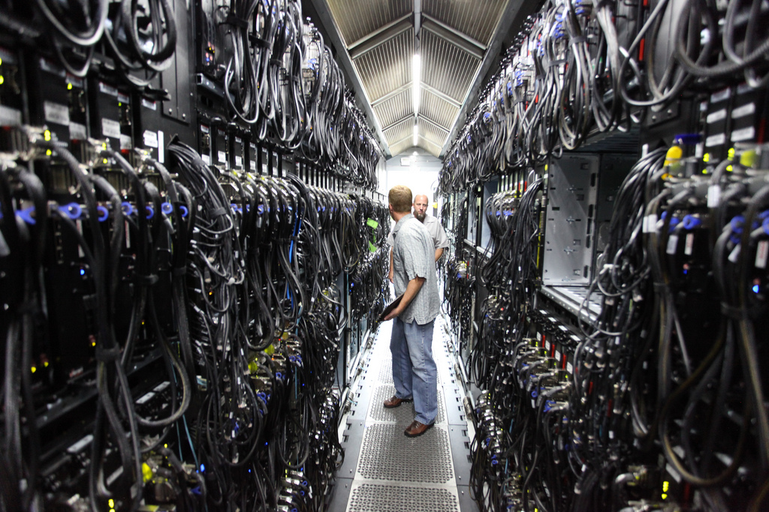
DISTRIBUTED COMPUTING
IS THE
NEW NORMAL
ORDER IS TOO COSTLY
Coordination
THE STATE IS HEARSAY
Delay
Failure
http://www.flickr.com/photos/scobleizer/4870003098/sizes/l/in/photostream/

Slide 6
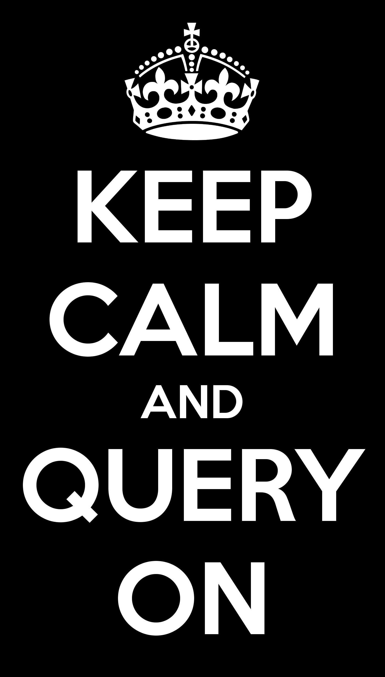
DISORDERLY PROGRAMMING
STATE
Order-insensitive objects
LOGIC
Order-insensitive merge rules
IMPLICATION: KEEP CALM
Asynchrony is irrelevant
Replication is easy
Coordination is unnecessary
Not always possible! But often.
Disorder by default
Order is the exception.
The CALM Theorem says when.
http://www.flickr.com/photos/scobleizer/4870003098/sizes/l/in/photostream/

Slide 7
<~ bloom
A disorderly distributed language as above
[Hellerstein, et al. CIDR11]
http://bloom-lang.org
Ruby prototype: Bud
Theoretical grounding: Dedalus
A logic for data, space and time
Model-theoretic (fully declarative) semantics
[Alvaro, et al. Datalog2.0-11, Datalog2.0-12]
% gem install bud

Slide 8

<~ bloom
A disorderly distributed language as above
[Hellerstein, et al. CIDR11]
http://bloom-lang.org
Ruby prototype: Bud
Theoretical grounding: Dedalus
A logic for data, space and time
Model-theoretic (fully declarative) semantics
[Alvaro, et al. Datalog2.0-11, Datalog2.0-12]
% gem install bud

Slide 9
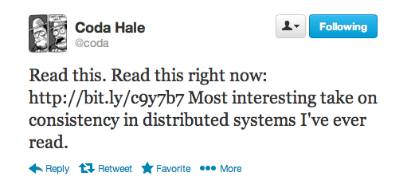
<~ bloom
A disorderly distributed language as above
[Hellerstein, et al. CIDR11]
http://bloom-lang.org
Ruby prototype: Bud
Theoretical grounding: Dedalus
A logic for data, space and time
Model-theoretic (fully declarative) semantics
[Alvaro, et al. Datalog2.0-11, Datalog2.0-12]
% gem install bud

Slide 10
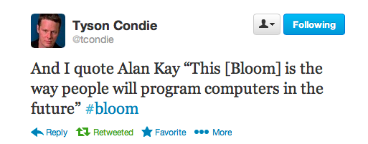
<~ bloom
A disorderly distributed language as above
[Hellerstein, et al. CIDR11]
http://bloom-lang.org
Ruby prototype: Bud
Theoretical grounding: Dedalus
A logic for data, space and time
Model-theoretic (fully declarative) semantics
[Alvaro, et al. Datalog2.0-11, Datalog2.0-12]
% gem install bud

Slide 11

CS194-17 at Berkeley: Programming the Cloud
Joe Hellerstein & Peter Alvaro
Now in its second offering.
Tuesdays: Big Picture
lectures on distributed systems fundamentals
Thursdays: Hands On
live-coding in Bloom
We’ll do a bit of a blend today…

Slide 12
Lessons for Today
Communication as Rendezvous in Space & Time
The Duality of Communication and Storage
Assessing the need for Coordination protocols
CALM program analysis

Slide 13
Lessons for Today
Communication as Rendezvous in Space & Time
The Duality of Communication and Storage
Assessing the need for Coordination protocols
CALM program analysis

Slide 14
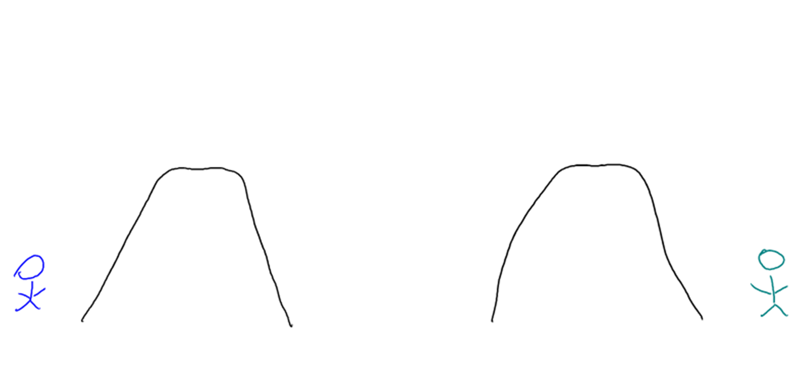
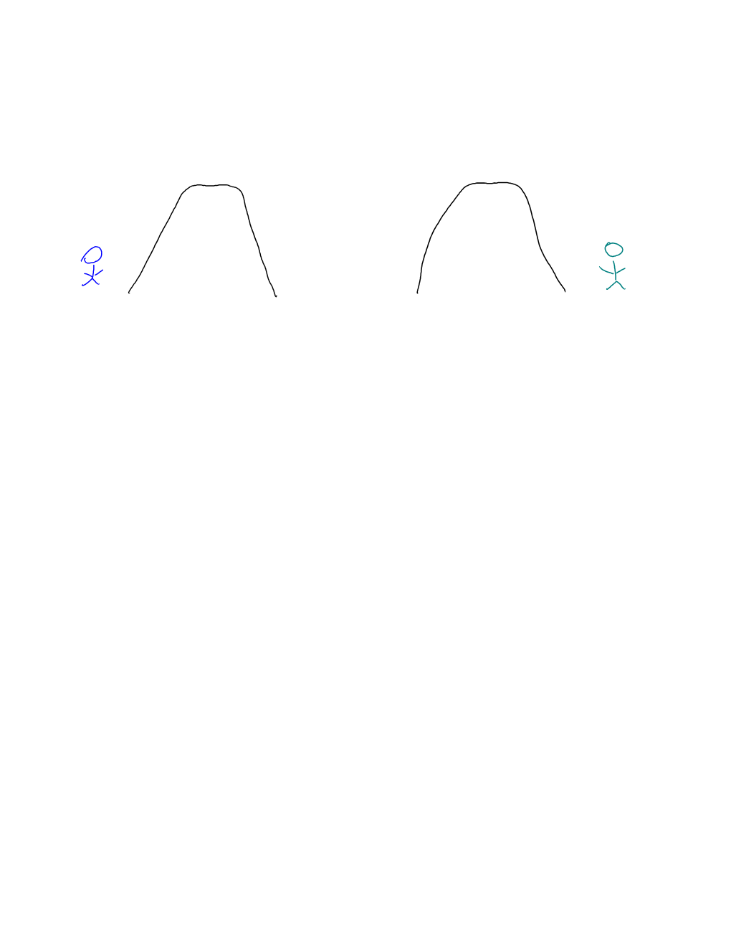

The Land of Two Mountains

Slide 15
Rendezvous by Luck (Smoke Signals)

Slide 16

Sender Persists

Slide 17
Receiver Persists

Slide 18
Both Persist

Slide 19
Lessons for Today
Communication as Rendezvous in Space & Time
The Duality of Communication and Storage
Assessing the need for Coordination protocols
CALM program analysis

Slide 20
Lessons for Today
Communication as Rendezvous in Space & Time
The Duality of Communication and Storage
Assessing the need for Coordination protocols
CALM program analysis

Slide 21
Directions for Thought
Thm (CALM): Consistency As Logical Monotonicity
<= : Distributed code that’s monotonic will be “eventually consistent” without coordination.
Corollary: It is sufficient to use coordination only to “guard” the non-monotonic statements in a program.
=> : Any eventually consistent program is in some fundamental way monotonic.
Said differently:
“Thank you for all the Paxos, Dr. Lamport. Do I need it?”
Or perhaps better: “What is time for? Must I spend it?”
[Hellerstein, SIGMODRecord 3/10; Ameloot PODS11, ICDT12, Marczak Datalog 2.0-12]
Realized in practice via Bloom/Budplot.

Slide 22
More Results
http://boom.cs.berkeley.edu
http://bloom-lang.org
Materials for this talk:
https://github.com/programthecloud/ptcrepo/tree/gh-pages/demo

Slide 23



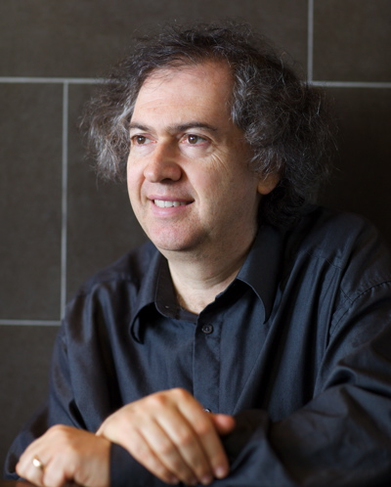









BOOM TEAM
joe hellerstein
david maier
ras bodik
alan fekete
peter alvaro
peter bailis
neil conway
bill marczak
haryadi gunawi
sriram srinivasan
Joshua rosen
emily andrews
andy hutchinson

Slide 24
Key Results 1
BOOM Analytics [Alvaro, et al. Eurosys ‘10]
HDFS rebuilt in Overlog, the predecessor to Bloom, with HA and scale-out
Hadoop scheduler as well
Bloom^{L}: Beyond sets/tables [Conway, et al. SoCC ‘12]
Extensions for natural monotone data types like counters, vector clocks, KVS with commutative merges
Safe mappings between these types
Blazes: Coordination analysis of streaming services [Alvaro, et al. In process]
Grey-box: bring CALM analysis to popular streaming systems like Storm
White-box: more fully automated stream analysis in the Bloom context
Correct, Composable Concurrent Editing [Conway, et al. In process]
Google-Doc style concurrent editing remains a black art
Operational Transforms
Lattices underlie a lot of the intuition
Bloom^{L} provides a rich language for composing lattices and traditional data
Automated analysis of correctness

Slide 25
Key Results 2
Consistency and Causality in the Wild (Bailis et al.)
Probabilistically Bounded Staleness [VLDB ‘12]
Dangers of Causal Consistency and a Solution [SoCC ‘12]
HAT, not CAP: Towards Highly Available Transactions [HotOS ‘13]
Bolt-On Causal Consistency [SIGMOD ‘13]

Slide 26
Summing Up
Distributed? Disorderly by default.
Logic and Lattices in Space and Time
The Duality of Communication and Storage
Unifying the two linguistically makes for nice code
Assessing the need for Coordination protocols
CALM leads to straightforward program checks in Bloom
Points to games we can play in other languages/systems
Many interesting questions remain

